Slide 1
DragonSec SI
Notes:
Lepo pozdravljeni na DCTF24 Konferenci! Moje ime je Aljaž, team captain naše skupine, DragonSec SI.
Rad bi se vam zahvalil, da ste se konference udeležili v tako velikem številu.

Slide 2
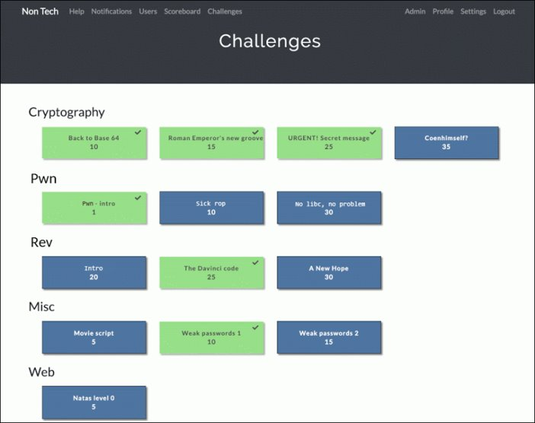
Jeopardy CTF
What is a ctf?
3 types (local,server,mixed)
Different categories (rev,pwn,web,crypto,misc...)
Example:
dctf{thi5_i5_4_t3st_f14g}

Slide 3
Web
Typically has a server
Remote connection
Threat hunting:
https://owasp.org/www-project-top-ten/ (OWASP top 10)
Mistakes in code; PHP, Javascript, SQL ...

Slide 4
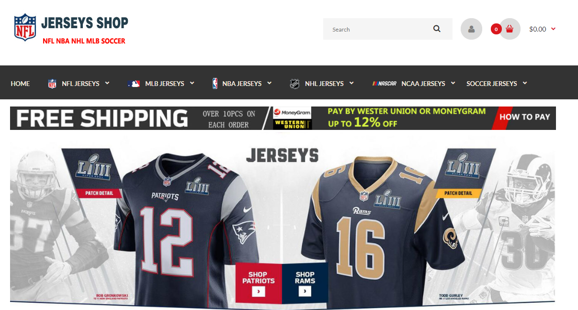
Web

Slide 5
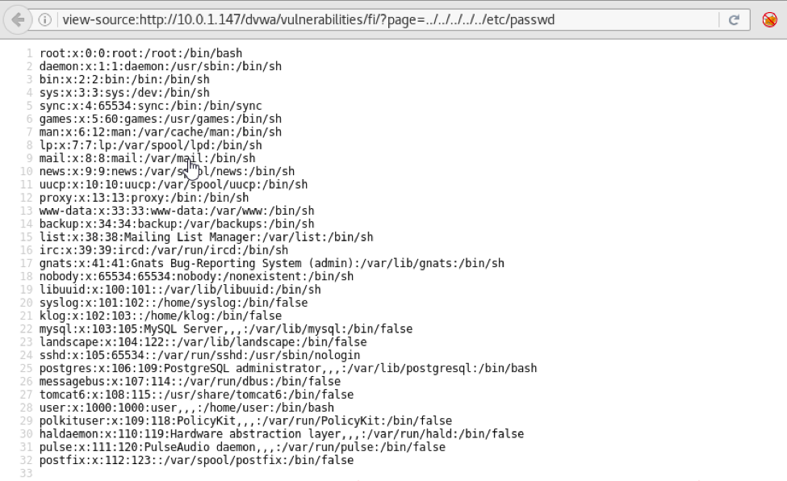
Web

Slide 6
Web
Helpful tools:
BurpSuite
Postman
curl
Inspect element

Slide 7
Crypto
Usually local
We get a cryptogram
Example:
wizTKW{nvct0d3_k0_tipgk0}
2b967640793d1e97a3b7d22b12d37b61
friCTF{welc0m3_t0_crypt0}
iloveponies

Slide 8
Crypto
Helpful tools:
Cyberchef (https://cyberchef.org/)
Sage
Python + PyCryptodome

Slide 9
Rev (reverse engineering)
Similarly, usually local
We get a binary program without original source code
The goal is to understand the program’s inner workings

Slide 10
Rev (reverse engineering)
Helpful tools:
Ghidra
IDA
ldd

Slide 11
Pwn (binary exploitation)
Usually remote
Similarly to reverse engineering, we only get the binary and no source code
In addition to reverse engineering, we need to also find a vulnerability to explot
Usually some form of memory corruption
We force the program into executing something it’s not meant to

Slide 12
Pwn (binary exploitation)
Helpful tools:
Ghidra
IDA
Pwntools
GDB with pwndbg or gef

Slide 13
Misc.
Everything else!
OSINT
Forensics
Jail escapes
Hardware challenges (please return the boards at the end of the competition)

Slide 14
Where can I find CTF challenges
Vulnhub (https://www.vulnhub.com/)
CTFtime (https://ctftime.org/)
TryHackMe (https://tryhackme.com/)
HackTheBox (https://www.hackthebox.eu/)

Slide 15
Where can I learn more?
Hacking Articles (https://www.hackingarticles.in/)
CTFtime writeups (https://ctftime.org/writeups)
IppSec (https://www.youtube.com/c/ippsec/)
LiveOverflow (https://www.youtube.com/c/LiveOverflow/)
…
PRACTICE, PRACTICE, PRACTICE.

Slide 16
Good luck!
dctf.si

